Slide 1
Stacks and Queues
Slides by:
Syed Zain Ul Hassan

Slide 2
Stack
A stack is an ordered list in which insertion and deletion are done at one end, called TOP. The last element inserted is the first one to be deleted. Hence, it is called the Last in First out (LIFO) or First in Last out (FILO) list
Insertion in a Stack is called Push
Deletion in a Stack is called Pop

Slide 3
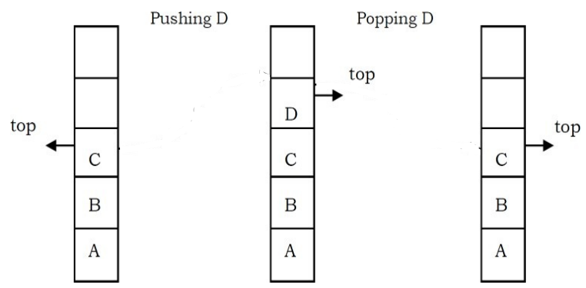
Example

Slide 4
Illustration

Slide 5
Applications
Infix to Postfix expression conversion
In function calls
Balancing of symbols (parenthesis, HTML tags etc.)
Back button in web browsers
Undo (Ctrl+Z) feature
Others...

Slide 6
Implementation: Using Array
class Stack {
// store elements of stack
private int arr[];
// represent top of stack
private int top;
// total capacity of the stack
private int capacity;
// Creating a stack
Stack(int size) {
// initialize the array
// initialize the stack variables
arr = new int[size];
capacity = size;
top = -1;
}
// push elements to the top of stack
public void push(int x) {
if (isFull()) {
System.out.println("Stack OverFlow");
// terminates the program
System.exit(1);
}
// insert element on top of stack
System.out.println("Inserting " + x);
arr[++top] = x;
}
// pop elements from top of stack
public int pop() {
// if stack is empty
// no element to pop
if (isEmpty()) {
System.out.println("STACK EMPTY");
// terminates the program
System.exit(1);
}
// pop element from top of stack
return arr[top--];
}

Slide 7
// check if the stack is full
public Boolean isFull() {
return top == capacity - 1;
}
// display elements of stack
public void printStack() {
for (int i = 0; i <= top; i++) {
System.out.print(arr[i] + ", ");
}
}
// return size of the stack
public int getSize() {
return top + 1;
}
// check if the stack is empty
public Boolean isEmpty() {
return top == -1;
}

Slide 8
public static void main(String[] args) {
Stack stack = new Stack(5);
stack.push(1);
stack.push(2);
stack.push(3);
System.out.print("Stack: ");
stack.printStack();
// remove element from stack
stack.pop();
System.out.println("\nAfter popping out");
stack.printStack();
}
}

Slide 9
Using Stack class
import java.util.Stack;
class Main {
public static void main(String[] args) {
Stack<String> fruits= new Stack<>();
fruits.push("Apple");
fruits.push("Orange");
fruits.push("Tomato");
System.out.println("Stack: " + fruits);
// pop element from top of stack
fruits.pop();
System.out.println("Stack after pop: " + fruits);
}
}

Slide 10
Implementation: Using Singly Linked List
Use the same functions provided with singly linked list
Use only Insert at the end function and remove the other insertion functions
Use only Delete from the end function and remove the other deletion functions

Slide 11
class StackUsingLinkedlist {
public class Node {
int data;
Node link;
}
// create global top reference variable global
Node top;
// Constructor
StackUsingLinkedlist() { this.top = null; }
public void push(int x) // insert at the beginning
{
// create new node temp and allocate memory
Node temp = new Node();
// check if stack (heap) is full. Then inserting an
// element would lead to stack overflow
if (temp == null) {
System.out.print("\nHeap Overflow");
return;
}
// initialize data into temp data field
temp.data = x;
// put top reference into temp link
temp.link = top;
// update top reference
top = temp;
}

Slide 12
public Node pop() // remove at the beginning
{
Node temp = new Node();
// check for stack underflow
if (top == null) {
System.out.print("\nStack Underflow");
return null;
}
else
{
temp=top;
top = (top).link;
return temp;
}
}

Slide 13
Peek
Check if there is any node present or not, if not then return. Otherwise return the value of top node of the linked list
public boolean isEmpty() { return top == null; }
public int peek()
{
// check for empty stack
if (!isEmpty()) {
return top.data;
}
else {
System.out.println("Stack is empty");
return -1;
}
}

Slide 14
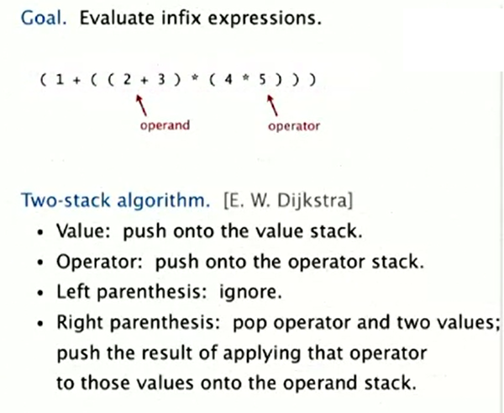

Slide 15
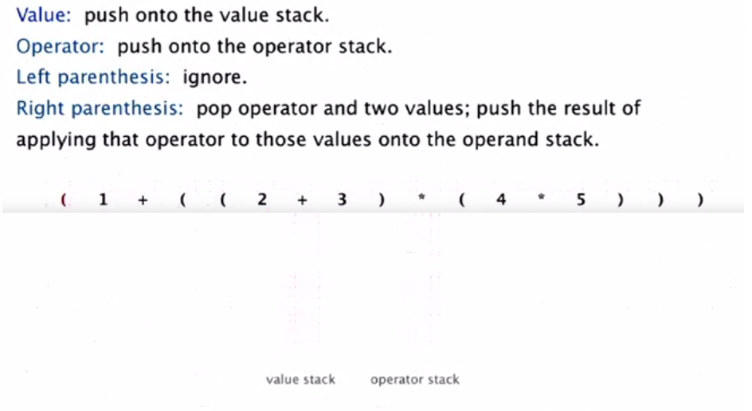

Slide 16
Queue
A queue is an ordered list in which insertions are done at one end (rear) and deletions are done at other end (front). The first element to be inserted is the first one to be deleted. Hence, it is called First in First out (FIFO) or Last in Last out (LILO) list

Slide 17
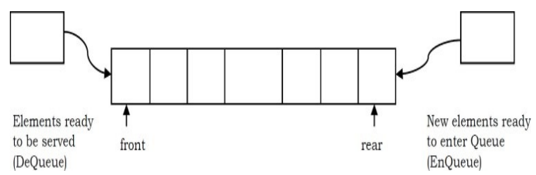
Example

Slide 18
Illustration

Slide 19
Applications
Scheduling tasks (in any area)
Data transfer in networks
Operating system process scheduling

Slide 20
Implementation: Using Array
// insert elements to the queue
void enQueue(int element) {
// if queue is full
if (isFull()) {
System.out.println("Queue is full");
}
else {
if (front == -1) {
// mark front denote first element of queue
front = 0;
}
rear++;
// insert element at the rear
items[rear] = element;
System.out.println("Insert " + element);
}
}
public class Queue {
int SIZE = 5;
int items[] = new int[SIZE];
int front, rear;
Queue() {
front = -1;
rear = -1;
}
// check if the queue is full
boolean isFull() {
if (front == 0 && rear == SIZE - 1) {
return true;
}
return false;
}

Slide 21
// delete element from the queue
int deQueue() {
int element;
// remove element from the front of queue
element = items[front];
// if the queue has only one element
if (front >= rear) {
front = -1;
rear = -1;
}
else {
// mark next element as the front
front++;
}
System.out.println( element + " Deleted");
return (element);
}
}

Slide 22
Using built in Queue interface
import java.util.Queue;
import java.util.LinkedList;
class Main {
public static void main(String[] args) {
// Creating Queue using the LinkedList class
Queue<Integer> numbers = new LinkedList<>();
// enqueue
// insert element at the rear of the queue
// enqueue
// insert element at the rear of the queue
numbers.offer(1);
numbers.offer(2);
numbers.offer(3);
System.out.println("Queue: " + numbers);
// dequeue
// delete element from the front of the queue
int removedNumber = numbers.poll();
System.out.println("Removed Element: " + removedNumber);
System.out.println("Queue after deletion: " + numbers);
}
}

Slide 23
C++ Implementation: Using Singly Linked List
Use the same functions provided with singly linked list
Use only Insert at the end function and remove the other insertion functions
Use only Delete from the beginning function and remove the other deletion functions

